Slide 1

Accessibility for disabled people in games
By Danial Nor Azman

Slide 2
Importance of accessibility in gaming
Inclusivity : Ensure that no one is left behind the gaming community
Equal Opportunities : Levels the playing field and provide a good gaming experience regardless of their disabilities
Increased Player Base : By making games accessible , game developers can go in a larger player base
Positive Impact : Accessible games can improve the quality of life of individuals with opportunities for leisure and entertainment

Slide 3
Eye Tracker
Controlling character movement
Interacting with in-game menus
Triggering actions by blinking or staring at specific objects in the game environment
Provides an accessible way for players with visual impairments to view details

Slide 4
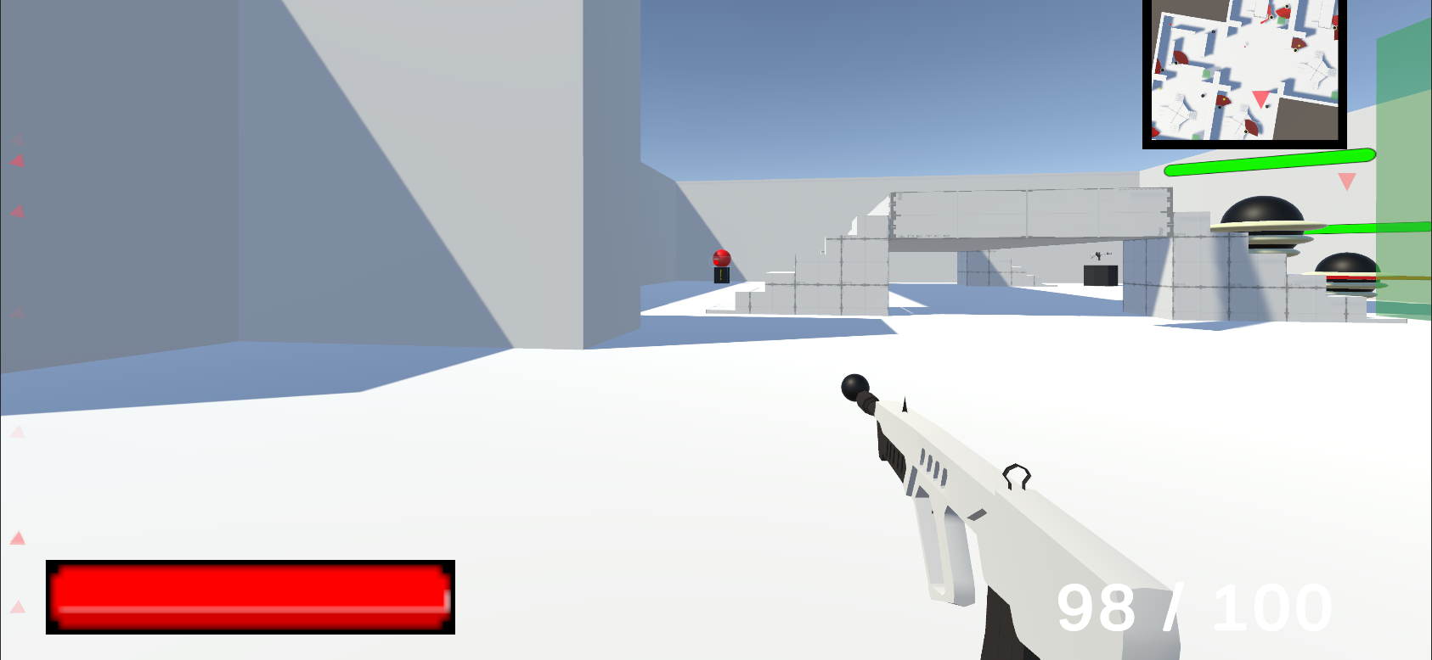
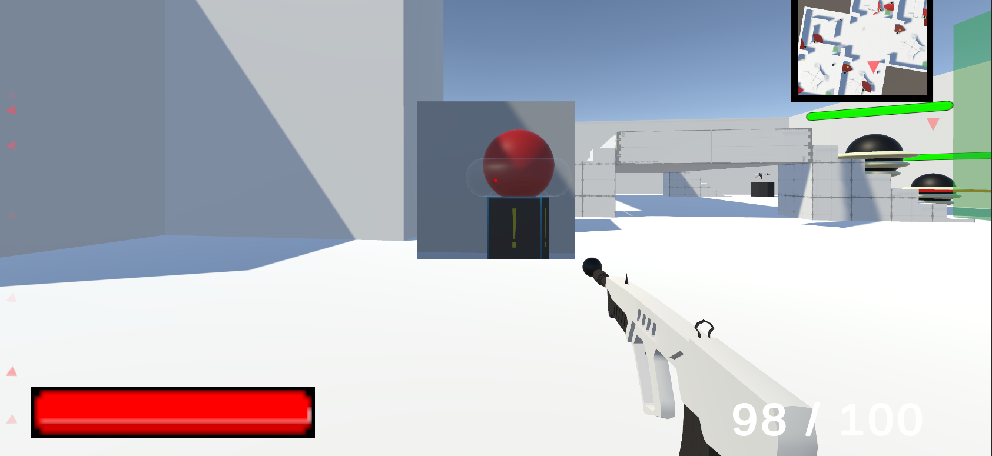
Magnifier
Before and After

Slide 5

3 Ways to do it
Use shader graph / write your own texture
Change the FOV of the camera
Use render texture of the camera and attached it to a Gameobject

Slide 6

Audio Cue
Importance of Audio
Audio is used to indicate actions , events , environmental changes or navigation.
Challenges faced by players with hearing impairments
Lose out on important information which affect gaming experience

Slide 7
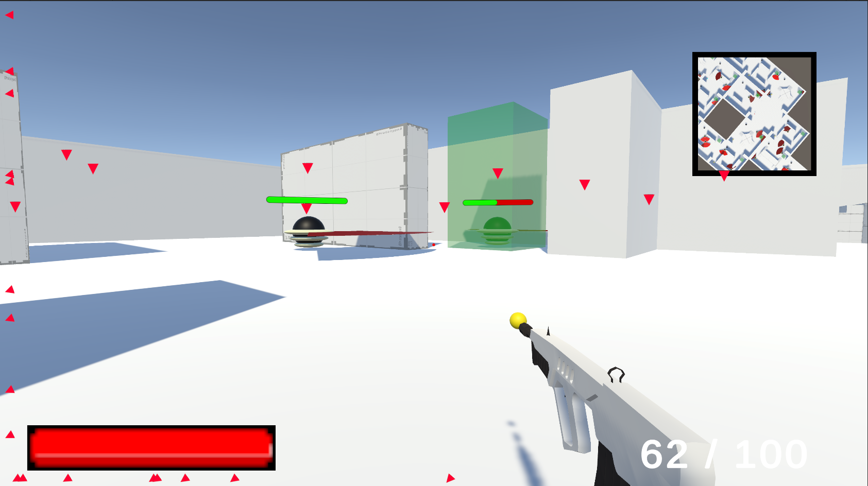
Alternative
Visual cues can be used to show sound produced in games.

Slide 8
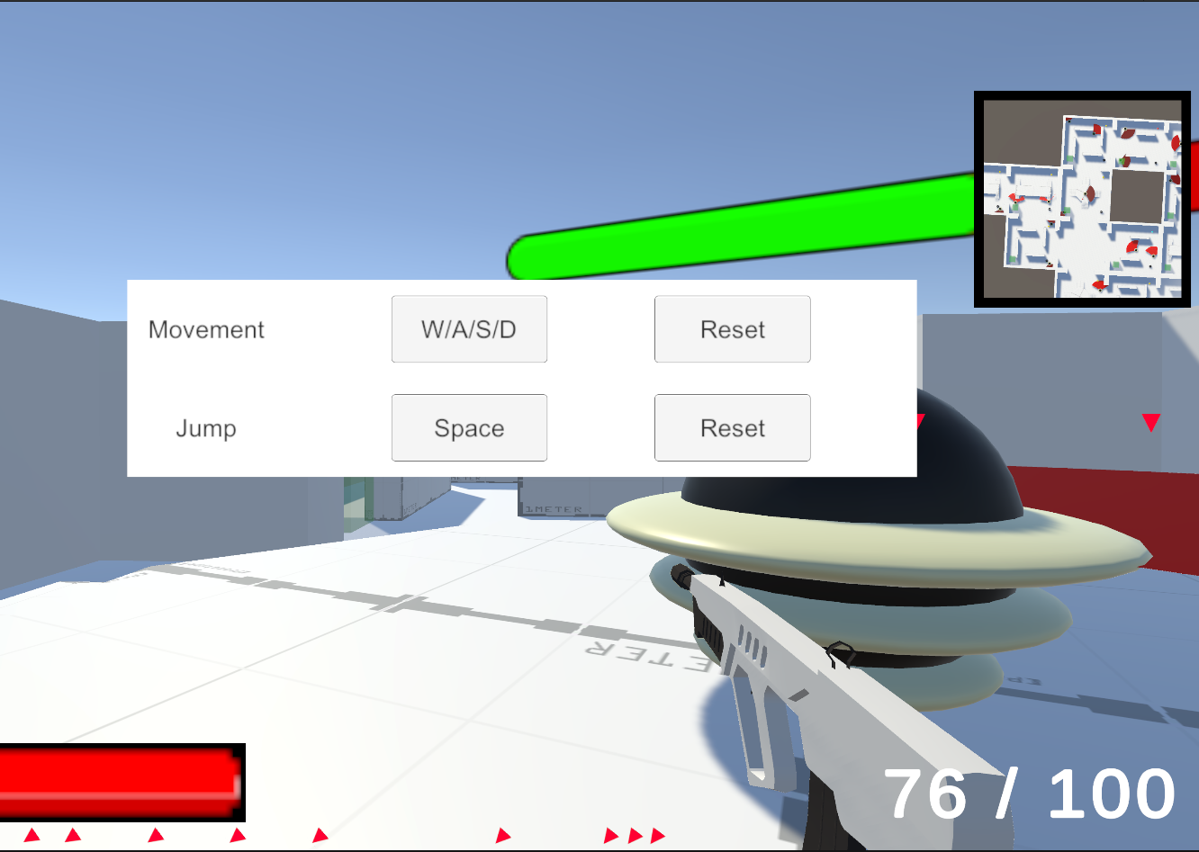
Customizable Controls

Slide 9
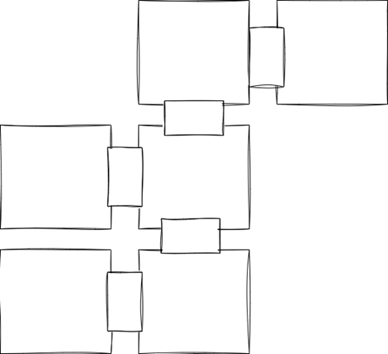
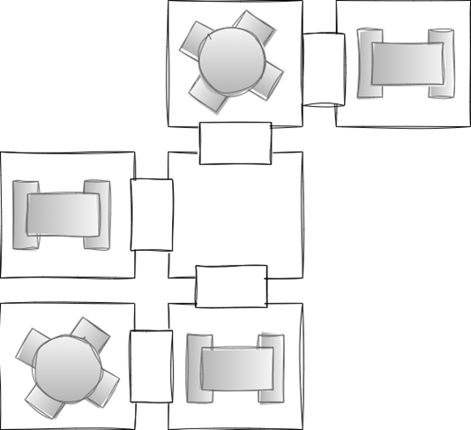
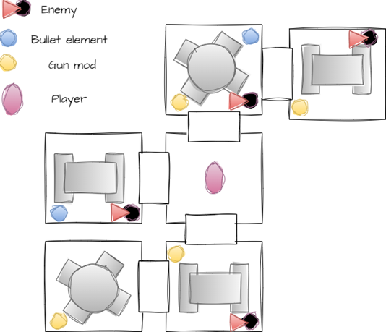
Level Generation

Slide 10
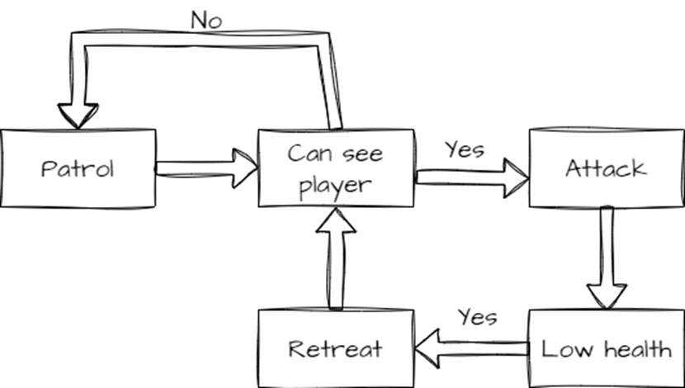
State machine

Slide 11
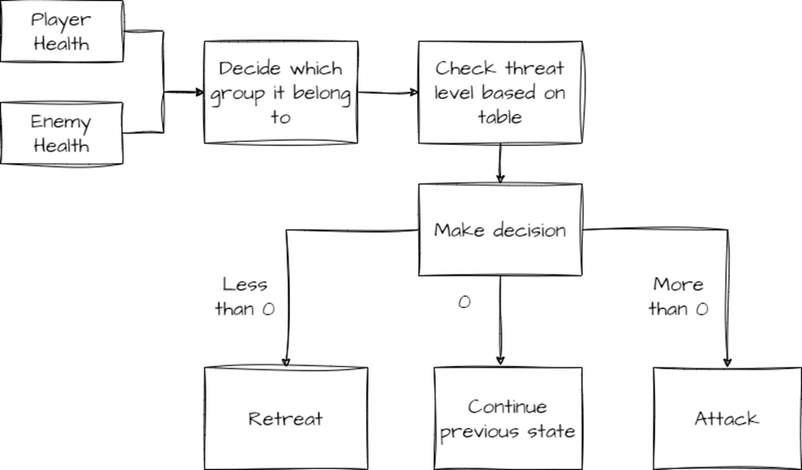
Fuzzy Logic

Slide 12

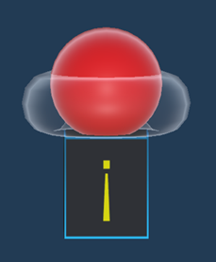


Bullet Elements
Use dictionary to link the color with the element
Effect is based on element of the bullet

Slide 13
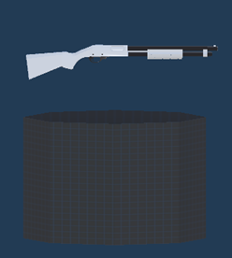
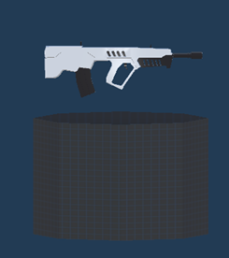
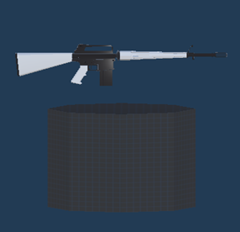
Gun Type
Burst – Fires 3 bullets per clicked but required to be click again to fire
Assault – Continuous firing until reloading is required
Shotgun – First 5 bullet at once with spread

Slide 14
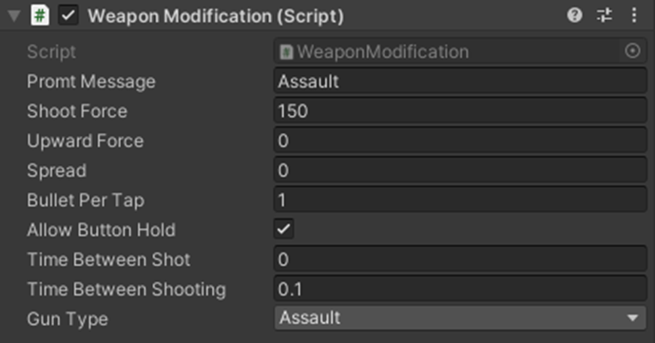
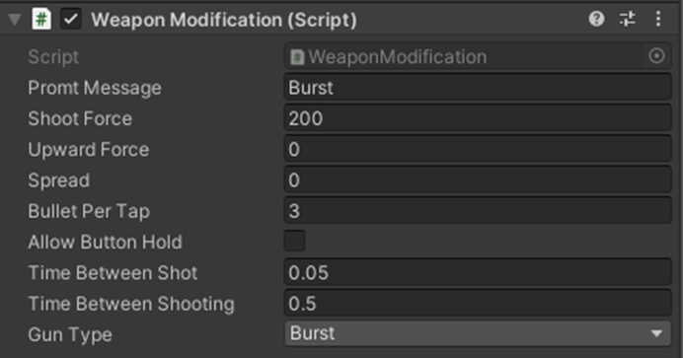
How I set it up

Slide 15
How I am planning to do my research
Develop an FPS roguelike game.
Include accessibility settings in the game.
Conduct playtesting sessions with individuals who do not use accessibility settings.
Allow individuals to replay the game with the accessibility settings enabled.
Take notes on any differences in behavior or effects observed during playtesting.

Slide 16
"How will the evaluation be tested?"
Visual cues: Evaluate effectiveness of visual cues, including highlighting important objects, clear indicators for progress/objectives, and easily discernible visual information for players with visual impairments.
Customizable controls: Test customization options for controls, such as remapping buttons/keys, adjusting sensitivity, and alternative input methods for comfortable and effective control for players with diverse physical abilities.
Magnifier for zoom: Evaluate ease of use and meaningful benefit of magnifier for zoom functionality for players with visual impairments

Slide 17
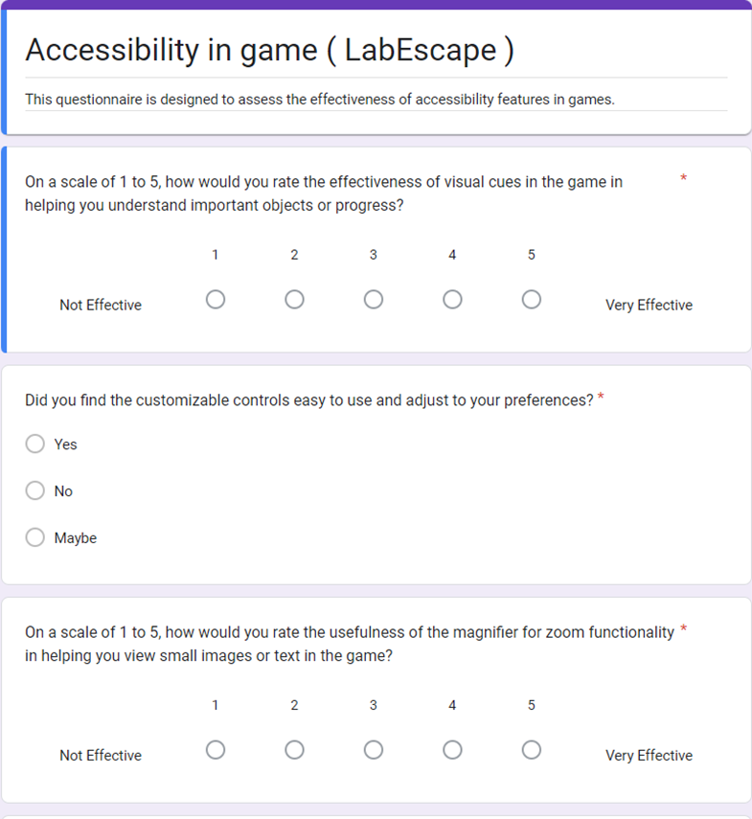
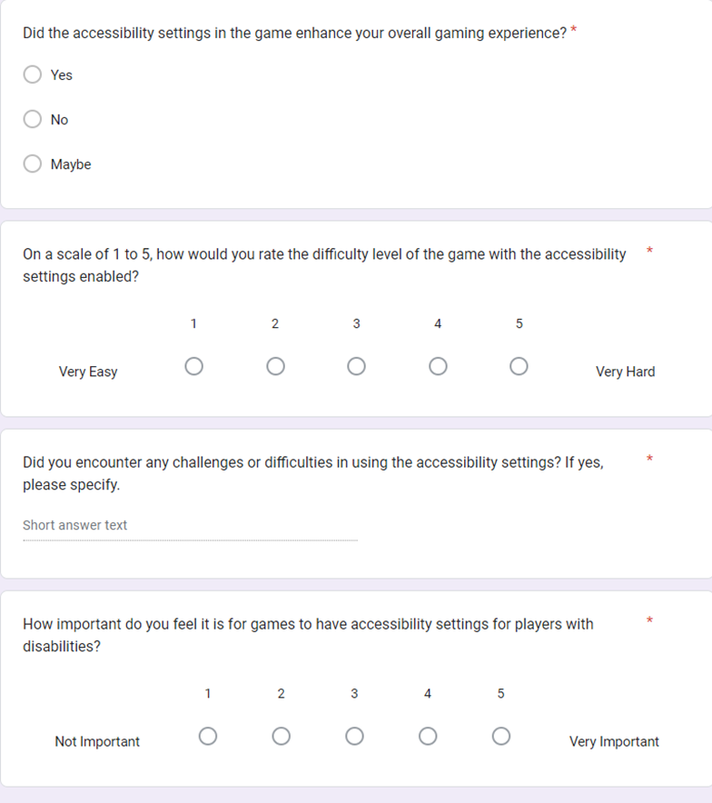
The questionnaire

Slide 18
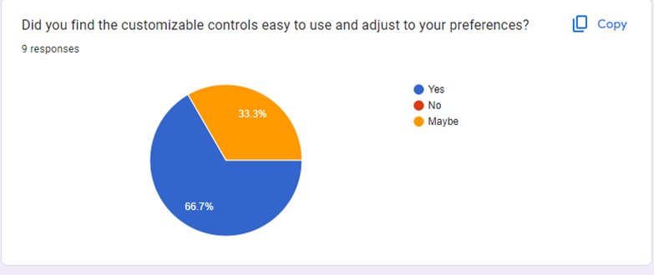
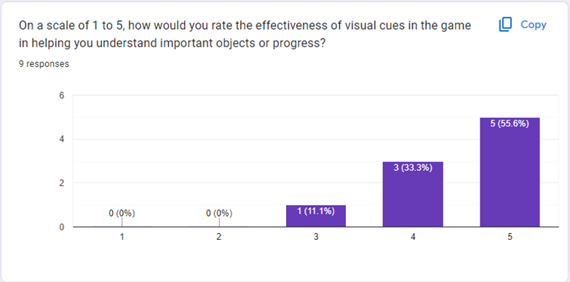
Results

Slide 19
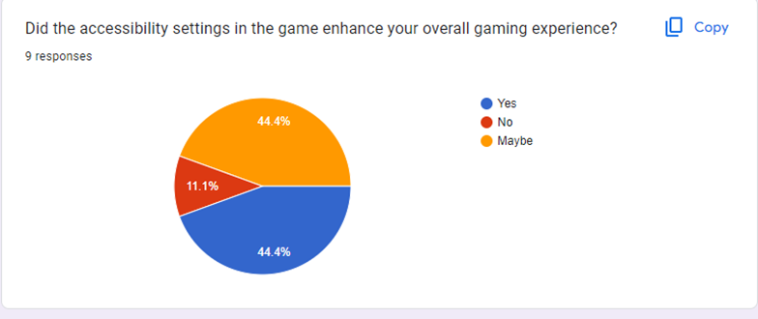
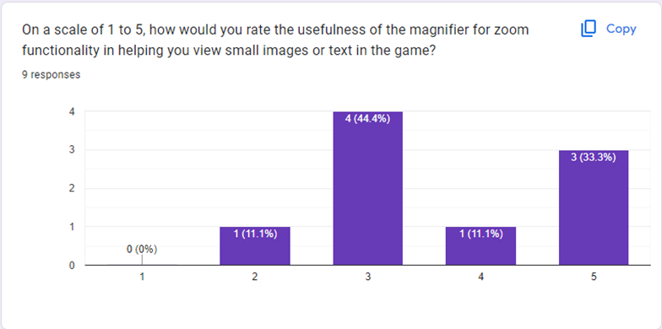

Slide 20
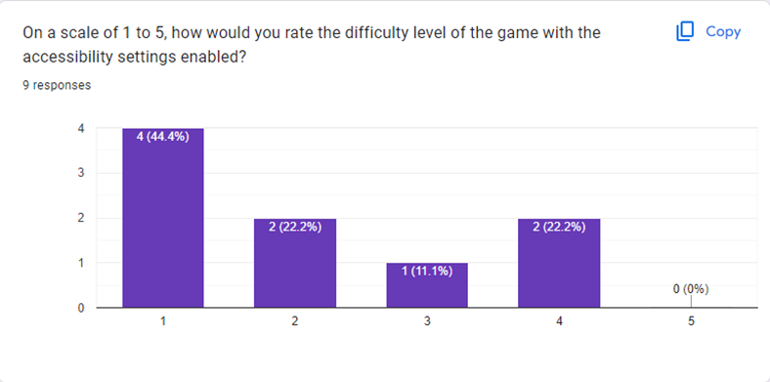
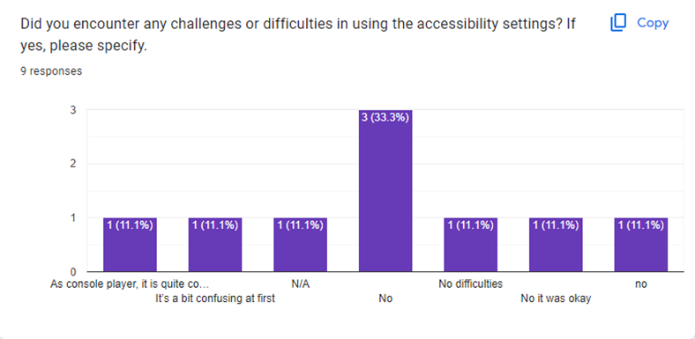

Slide 21
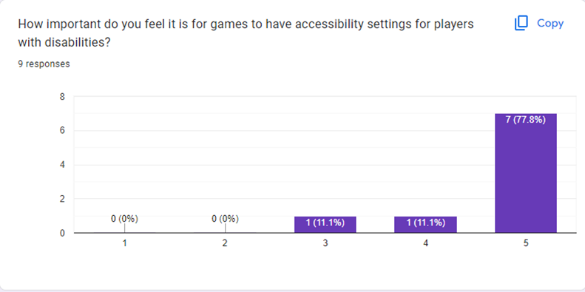

Slide 22
Limitation
Sample size
Number of accessibility

Slide 23
Conclusion
In conclusion, the findings indicate that the visual cues, customizable controls, and accessibility settings in the game were positively received by most participants and have the potential to enhance accessibility and adaptability. However, the magnifier received mixed opinions with most participants choosing 3 as their answers which indicate indifferent. The majority of participants recognized the importance of accessibility settings, highlighting the necessity of inclusive design in gaming.

